Slide 1

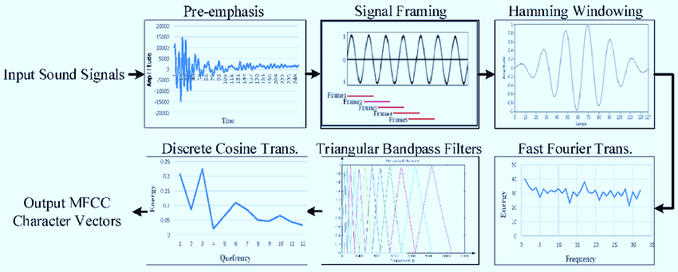
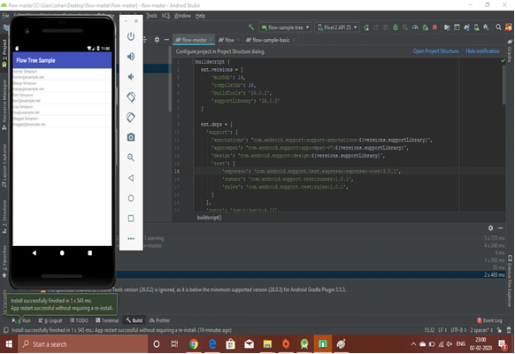
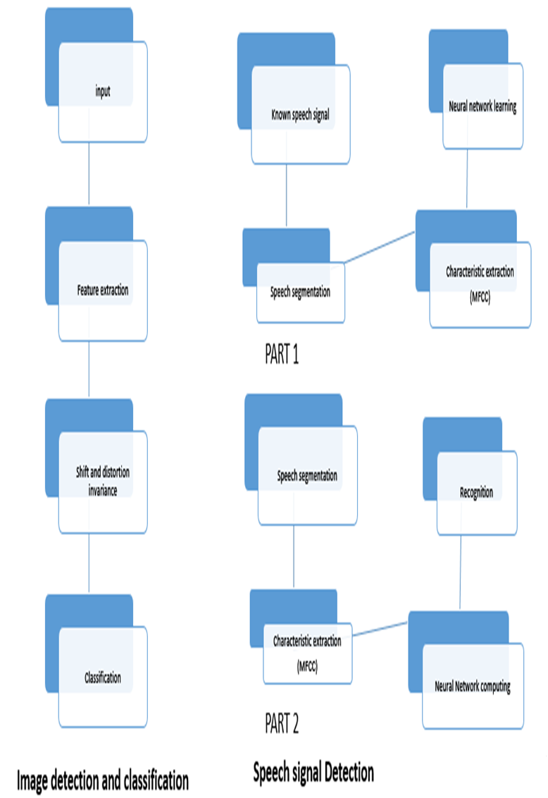
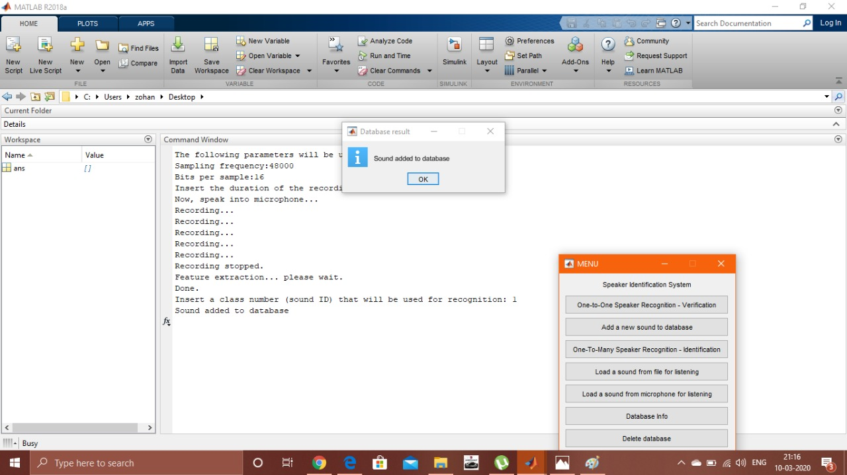
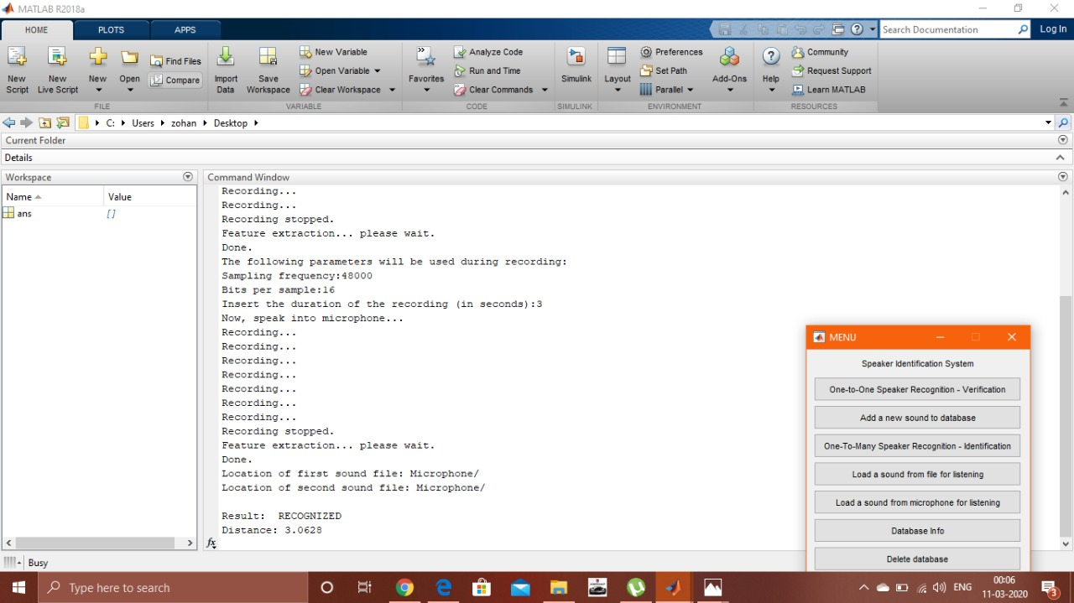
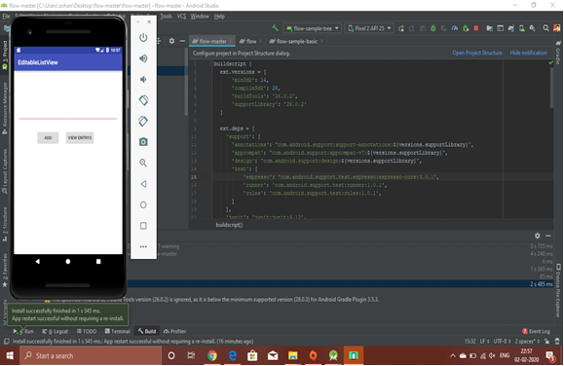
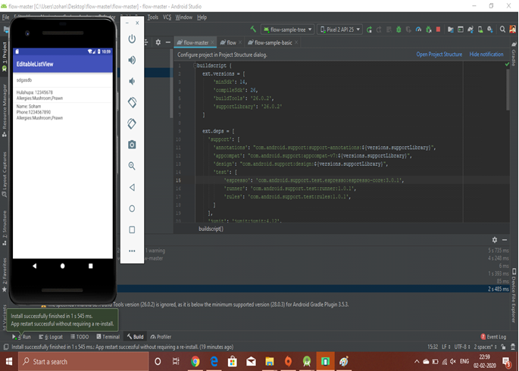
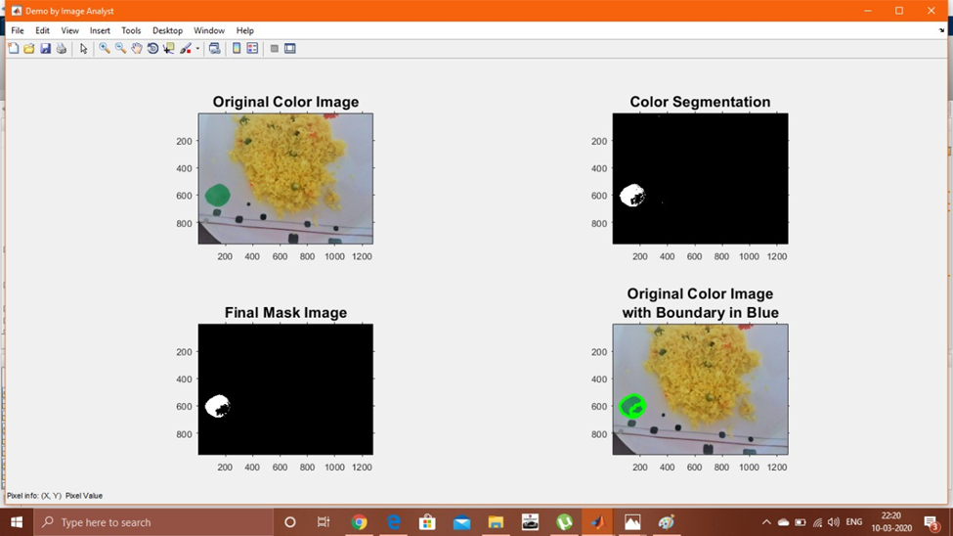
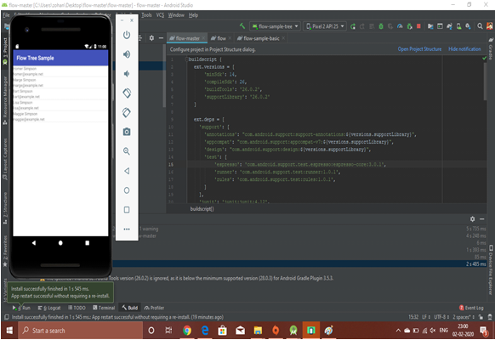
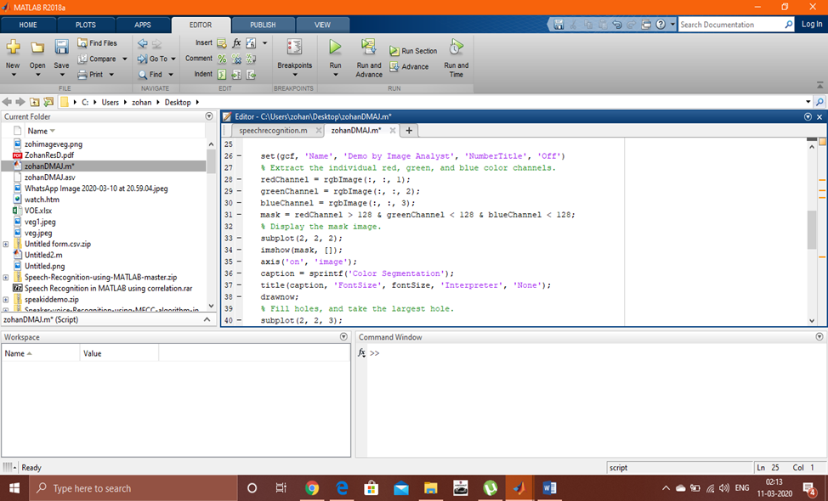
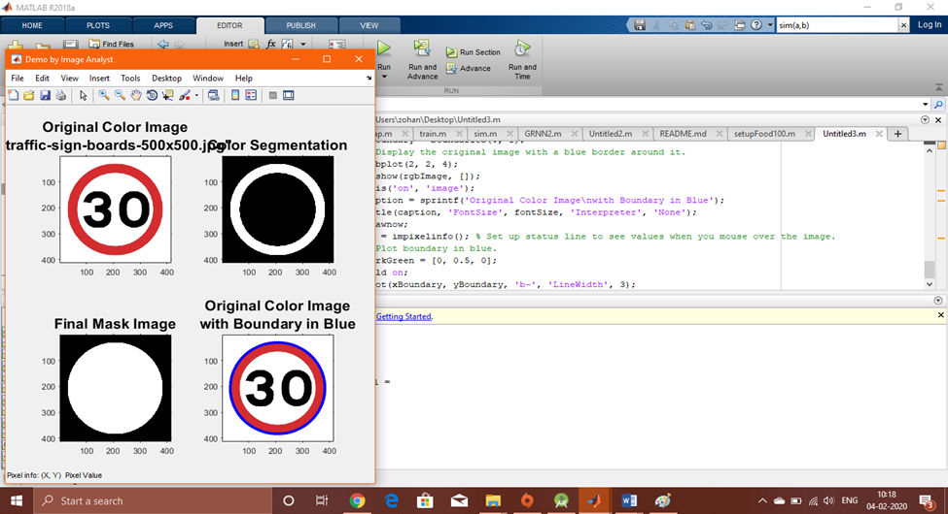
Autonomous Restaurant Serving System using Food Image Detection and Voice Detection
SOHAM DASGUPTA [Reg No:RA1611004010573] MADHURUPA SAMADDAR [Reg No:RA1611004010608]
YOGALAKSHMI C.N. [Reg No:RA1611004010745] SUBHIKSHA N [Reg No:RA1611004010123]
Dr. K. Vijayan
SRM INSTITUTE OF SCIENCE AND TECHNOLOGY
Abstract
System Architecture
Flow Diagram
Results and Inference
In recent times hotel management has been pretty important when it comes to business meets and food chains. Currently in India multiple food chains are running out of which many food chains are running internationally too. One of the most important aspects of these chains is the management of customers and customer satisfaction. The first part of this project aims at intelligently predicting the choices and the personal details of the customer. This prediction is done through voice recognition where the voiceprint of a person is detected to access the database of the person which consists of his/her previous orders and special changes in the menu. This helps in knowing about the allergic reactions of a person to some specific food items and a customizable menu can be provided to the person. This would greatly help in management of customer databases and customer satisfaction. The second part of the project deals with the food item detection algorithm using image processing so that veg and non veg food items do not get mixed up and the correct table receives the correct order.
MFCC System Architecture
Data Retrieval
Voice print detection using MFCCs
Voice detection
Data Entry
Objective
Methodology
Our aim is to innovate a device that is simple to use, affordable and of great value to sports.
The primary objective of this project is voiceprint recognition of the person so that the customer is not asked for additional personal details and also the database of the customer can be easily recognized using the voiceprint. This database can be used to customize the order for the customer making it easier for the restaurant or hotel to manage the customers.
The Secondary objective of the project is the detection of food items using image processing so that the correct order is always sent to the correct table . Moreover Vegan meals thus will never be mistaken for non veg meals
In this progress, we have created an app that can store all the datasets and works customer friendly. This helps the users to enjoy the tension free meal in adding specifics to their meal.
We will be using the Voice detection & Image detection processes for selection specific food to match the customer expectations
As part of this project , An effective algorithm(MFCC) should be set up for the feature extraction of the voice for recognition.
The details customer date is captured into the master database which is shared among all the systems.
To aid the customer for getting the similar facilities while visiting an outlet of the restaurant in a different country, a distributed database will help to retrieve the data for executing the voice recognition and image detection as per customer specific food requirements
As part of Image detection process a multilayer perceptron must be trained multiple times for effective detection of the food items and a colored dots on plates and food packages can be used for segregation of veg and non veg items.
Image detection & Speech recognition process
Realtime image detection
Database Management
Conclusion
Future Scope
In this project the ways of automating restaurant serving system and database access of customers is proposed. However there will always be some sources of error if we consider the factor of human error too. However the color coding procedure matched with the food image detection procedure shall lower the chances of error a lot.
The cost of the whole application will be less only to consider the cost fixed by the developer for the project and the license of the firebase servers. This cost is much less compared to the fully automated restaurants that are operating currently. The project aims at effectively lowering the cost of the entire system and as well as make the whole thing as much smart as possible.
Nowadays every aspect of business and living is completely focused on automation nowadays. In future this project aims at the automation procedure of taking orders and serving them in hotels and restaurants.
Currently available AI enabled hotels have an unnecessary heavy cost since multiple functions are performed by robots . This project aims at serving a similar purpose at much cheaper rates.
In future ,there is scope for automation to take over the current ways in which the food industry works as the cost of this project is much lesser than fully automated restaurants that are currently working.
Background & Problem Statement
The project aims at creating a personalized database which can be accessed through the voice recognition of the customer so that the customer never faces a problem in overseas outlets of the similar food chain.
The second problem statement is that veg and non veg foods get mixed up creating problems for customers.
The project aims at segregating veg and non veg food intelligently so that people with specific food choices (Jains and Vegans) never face a problem also to sort things out voice recognition.
Experimental/Simulation Setup
References
S. Sasano, X. Han and Y. Chen, "Food recognition by combined bags of color features and texture features," 2016 9th International Congress on Image and Signal Processing, BioMedical Engineering and Informatics (CISP-BMEI), Datong, 2016, pp. 815-819.
M. Wazumi, X. Han, D. Ai and Y. Chen, "Auto-recognition of food images using SPIN feature for Food-Log system," 2011 6th International Conference on Computer Sciences and Convergence Information Technology (ICCIT), Seogwipo, 2011, pp. 874-877.
W. Zhang, D. Zhao, W. Gong, Z. Li, Q. Lu and S. Yang, "Food Image Recognition with Convolutional Neural Networks," 2015 IEEE 12th Intl Conf on Ubiquitous Intelligence and Computing and 2015 IEEE 12th Intl Conf on Autonomic and Trusted Computing and 2015 IEEE 15th Intl Conf on Scalable Computing and Communications and Its Associated Workshops (UIC-ATC-ScalCom), Beijing, 2015, pp. 690-693
J. Meng, J. Zhang and H. Zhao, "Overview of the Speech Recognition Technology," 2012 Fourth International Conference on Computational and Information Sciences, Chongqing, 2012, pp. 199-202 doi: 10.1109/ICCIS.2012.202
G. K. Berdibaeva, O. N. Bodin, V. V. Kozlov, D. I. Nefed'ev, K. A. Ozhikenov and Y. A. Pizhonkov, "Pre-processing voice signals for voice recognition systems," 2017 18th International Conference of Young Specialists on Micro/Nanotechnologies and Electron Devices (EDM), Erlagol, 2017, pp. 242-245.
Architecture
Image Analysis
An Example
In this code the green channel has density more than the red channel for the green dot detection. Hence the green channel has a value greater than 128 .In the above picture, the biggest red dot with the most intensity is identified and detected.
Mel Frequency Cepstral Coefficients (MFCCs)
Dynamic Time Warping (DTW)
Distributed Database

